Slide 1
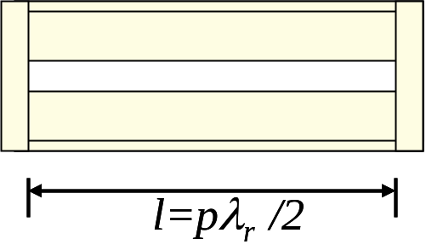
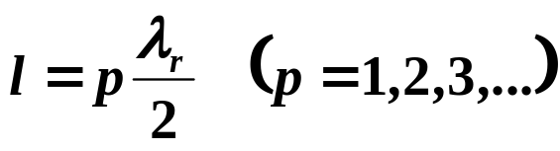
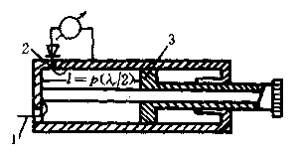
§6.2 Transmission line resonators
4. Coaxial resonator
(1) λ/2 coaxial resonator

Slide 2
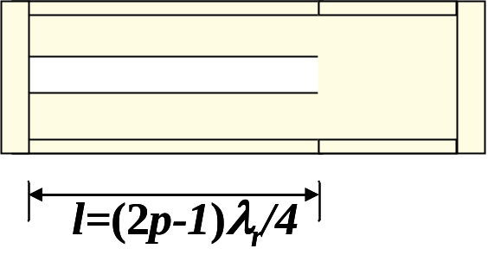
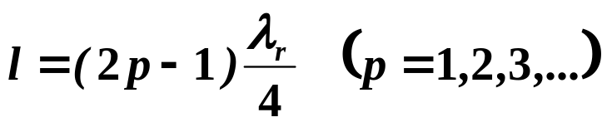
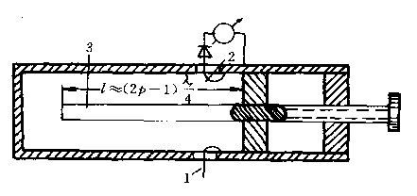
§6.2 Transmission line resonators
(2) λ/4 coaxial resonator

Slide 3
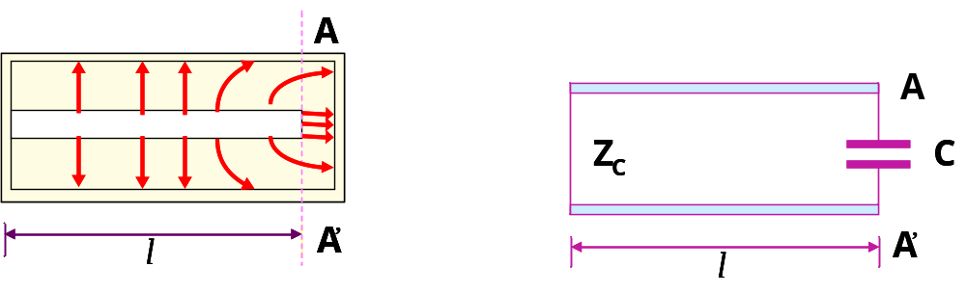

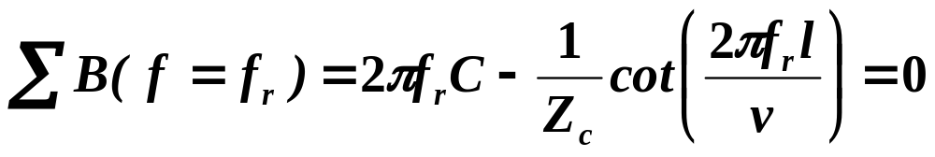
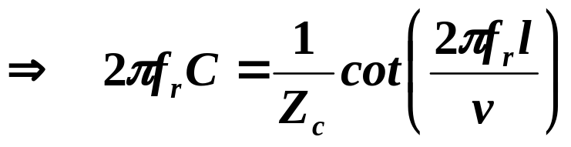
§6.2 Transmission line resonators
(3) Capacitor loaded coaxial resonator

Slide 4
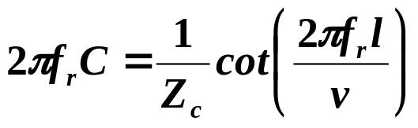
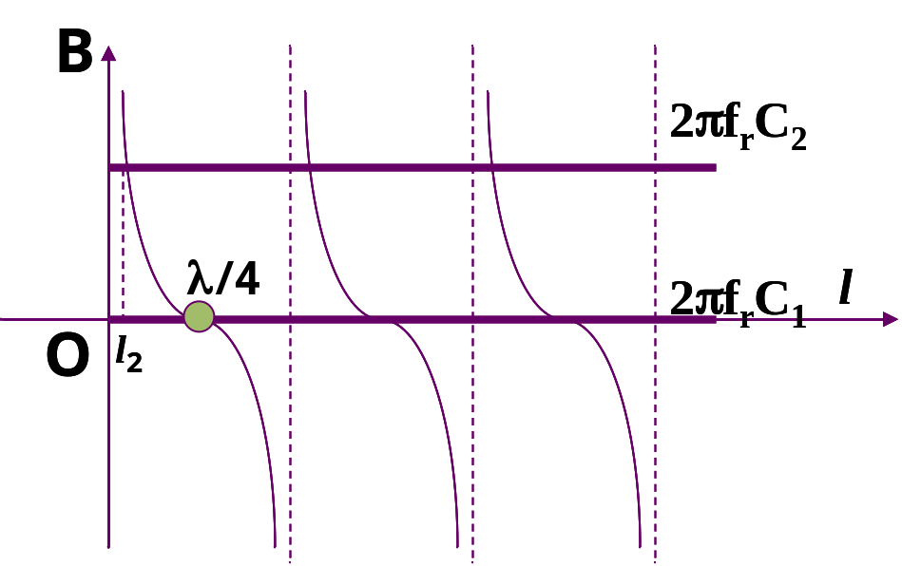
§6.2 Transmission line resonators

Slide 5
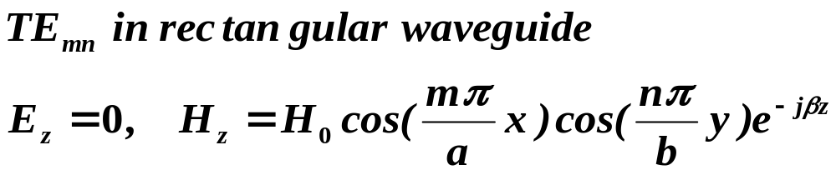
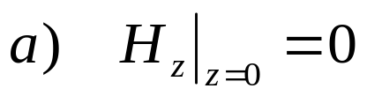

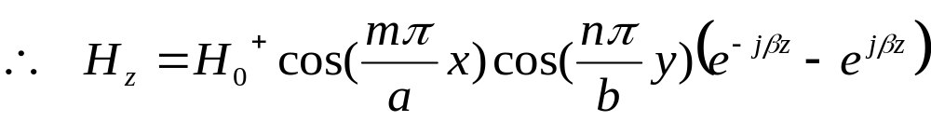
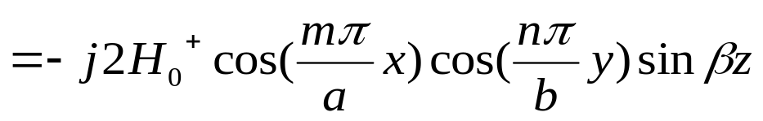
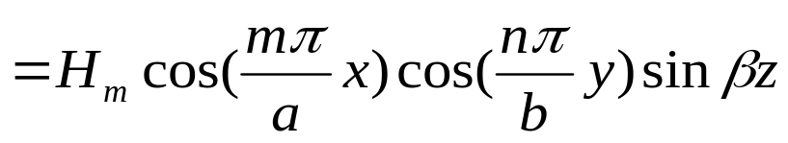
§6.3 Rectangular waveguide cavities
1. TE /TM resonant mode
（1）TE_{mnl}

Slide 6
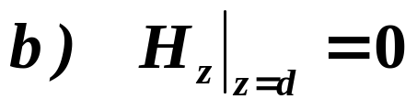
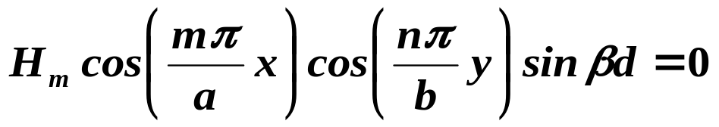
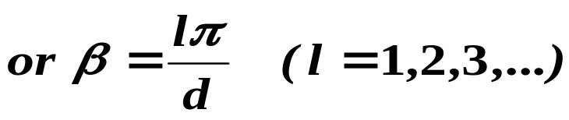

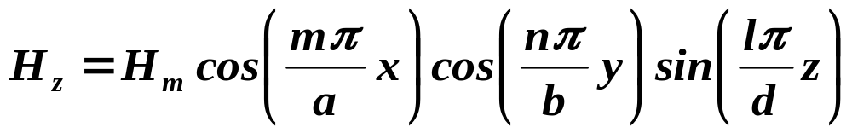
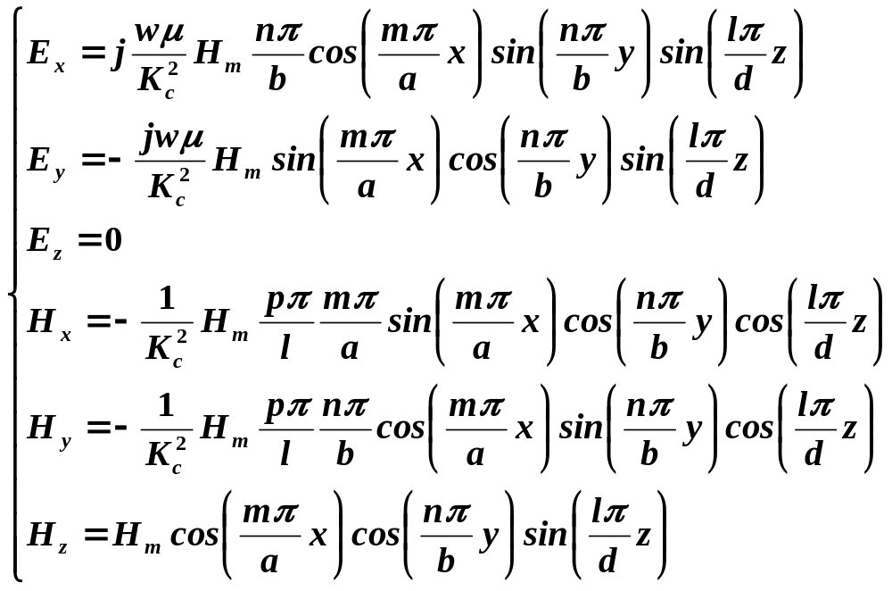
§6.3 Rectangular waveguide cavities

Slide 7
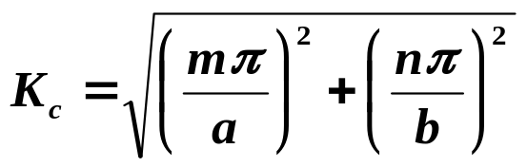
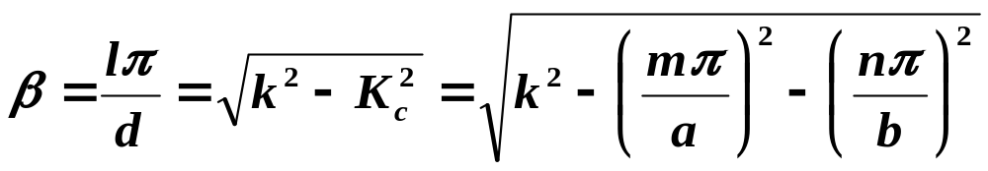

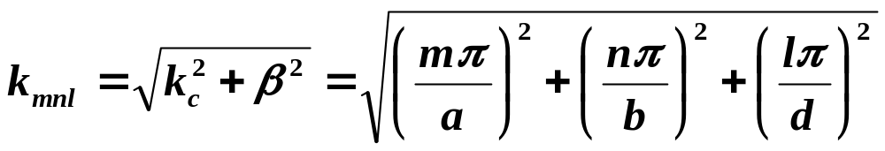
§6.3 Rectangular waveguide cavities
Resonant wavenumber

Slide 8
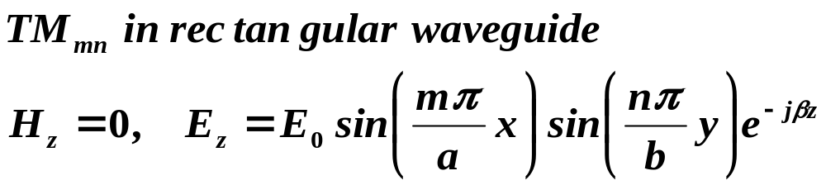
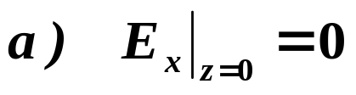

§6.3 Rectangular waveguide cavities
（2）TM_{mnl}

Slide 9
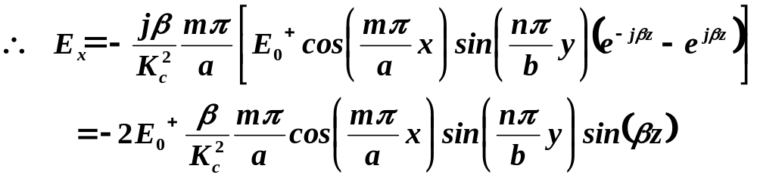
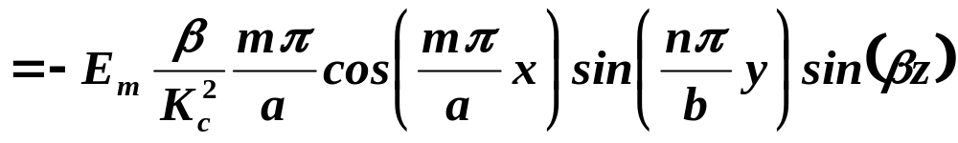
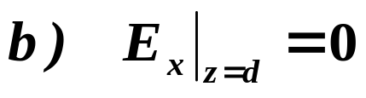
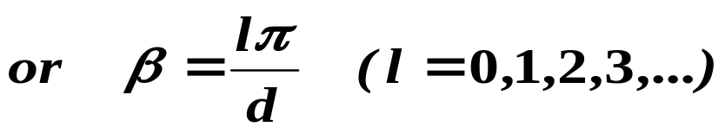

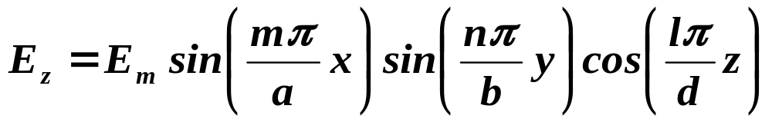
§6.3 Rectangular waveguide cavities

Slide 10
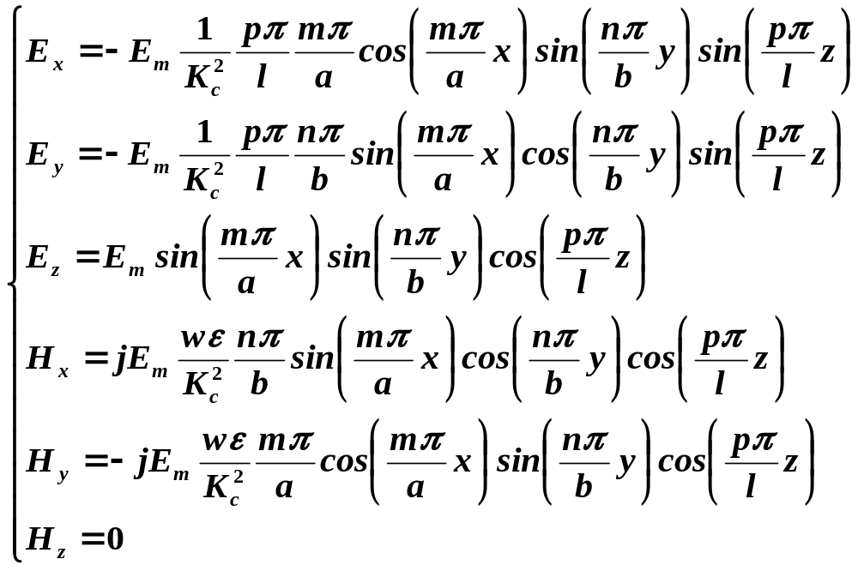
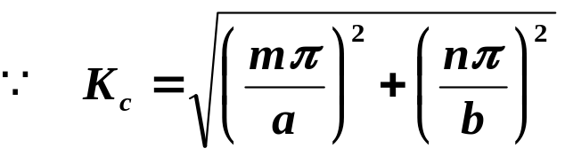
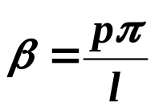
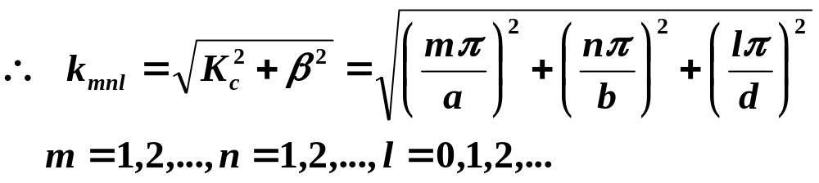
§6.3 Rectangular waveguide cavities
TM_{mnl} Resonant wavenumber

Slide 11
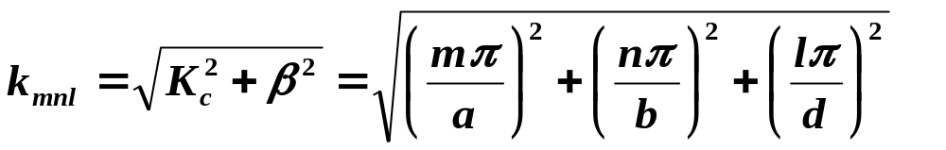
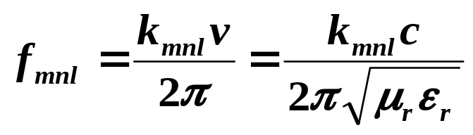
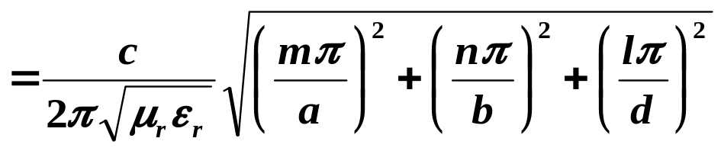
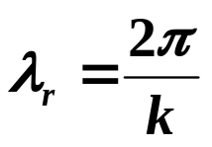
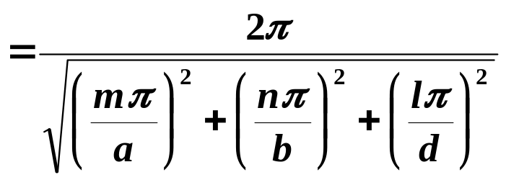
§6.3 Rectangular waveguide cavities
2. resonant frequency
Dominant resonant mode (lowest resonant frequency)
If b<a<d,
the dominant resonant mode will be theTE101 mode,
The dominant TM mode is TM110

Slide 12
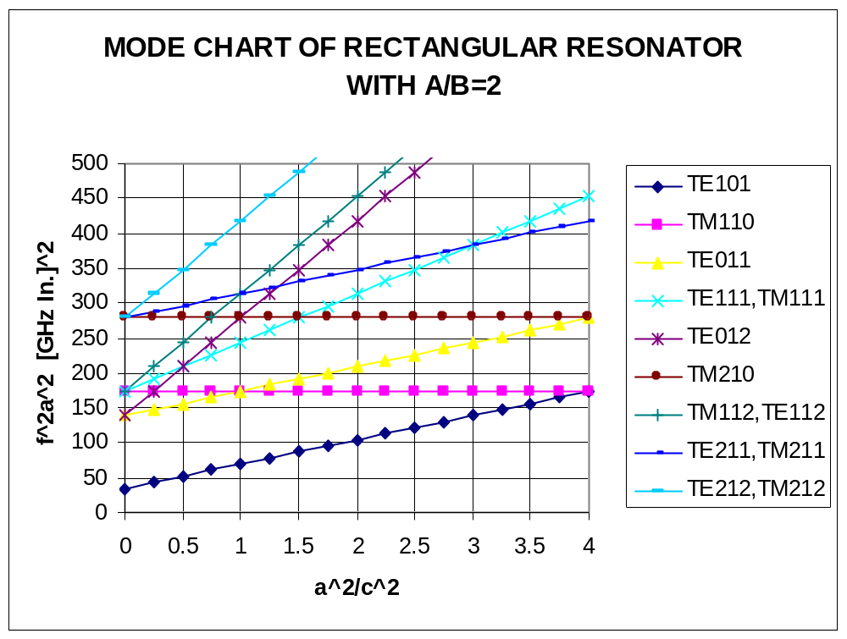
§6.3 Rectangular waveguide cavities

Slide 13
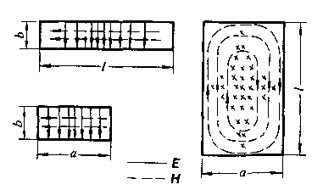
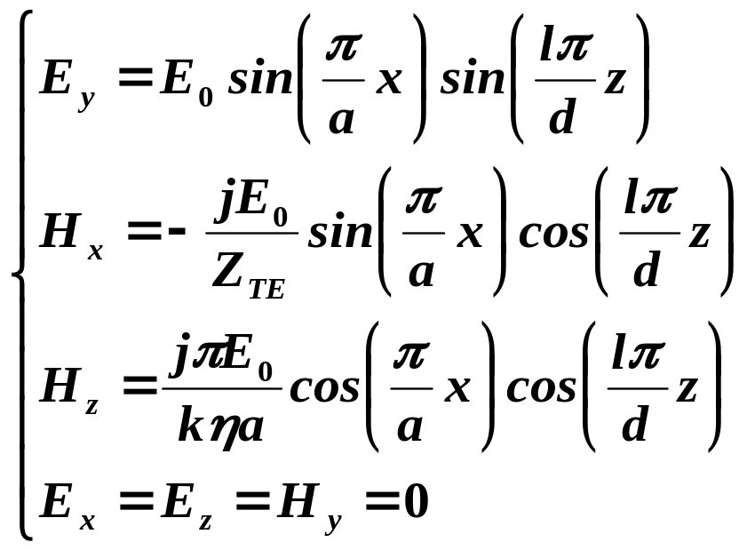
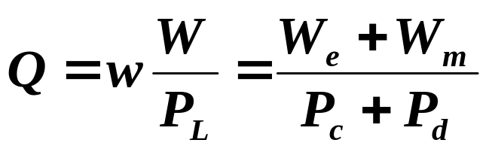
§6.3 Rectangular waveguide cavities
3. Q of the TE10l mode

Slide 14
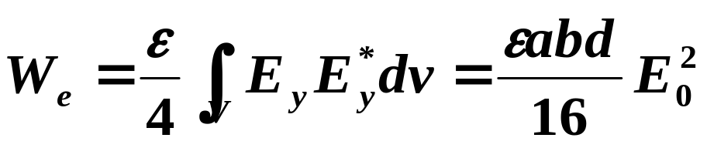
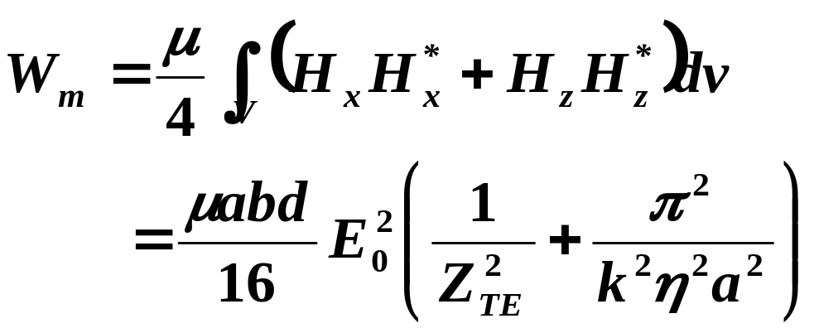
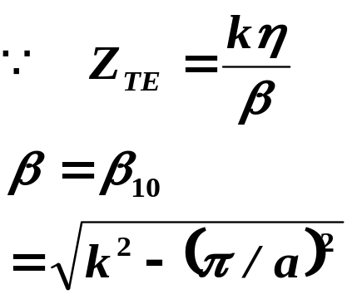
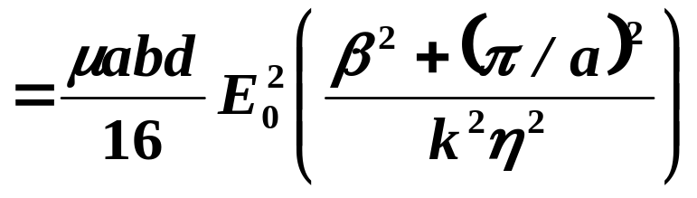
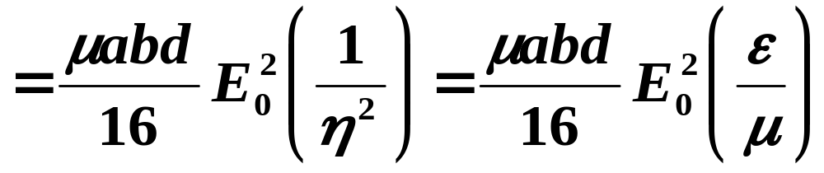
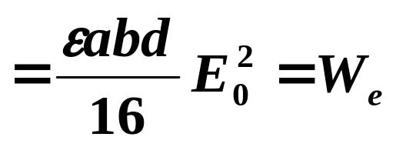
§6.3 Rectangular waveguide cavities

Slide 15





§6.3 Rectangular waveguide cavities

Slide 16




§6.3 Rectangular waveguide cavities
for an arbitrary resonant cavity mode

Slide 17




§6.3 Rectangular waveguide cavities
Example: Design of a rectangular waveguide cavity
A rectangular waveguide cavity is made from a piece of copper WR-187 H-band waveguide, with a= 4.755 cm and b= 2.215 cm. The cavity is filled with polyethylene (εr=2.25, tanδ= 0.0004). If resonance is to occur at f=5 GHz, find the required length, d, and the resulting Q for the l=1 and l=2 resonant modes.
Solution
for m=1,n=0，

Slide 18





§6.3 Rectangular waveguide cavities
The surface resistivity of copper at 5GHz is

Slide 19



§6.3 Rectangular waveguide cavities
The dielectric loss has the dominant effect on the Q;
Higher Q could thus be obtained suing an air-filled cavity

